Slide 1
Chains and graphs

Slide 2
LLMs are limited
Start
End
LLM
Access to knowledge
Tools
Multi-step processess
…

Slide 3
Therefore, many applications place LLM as one of many steps in the process
Start
...
End
Step 1
LLM
Step N

Slide 4
The flow structure is referred to as a chain
Start
...
End
Step 1
LLM
Step N
Chain (chain)

Slide 5
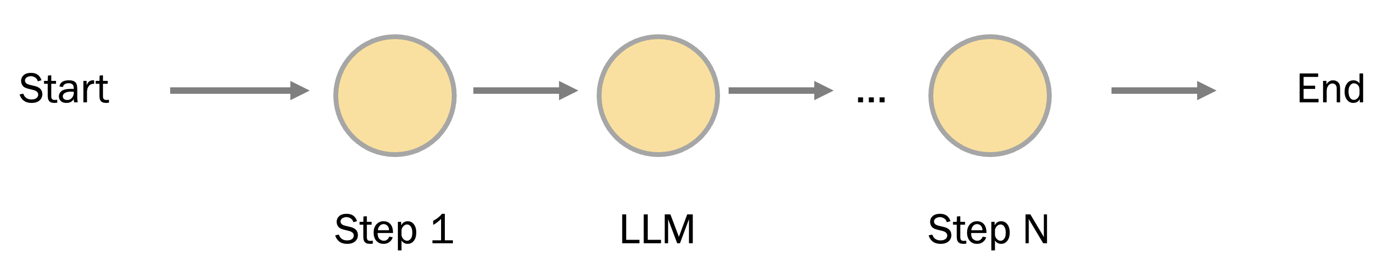
Such flows are predictable
launches
...

Slide 6
Start
End
But we expect Intelligence from AI....
Step 1
Step 2
Step 3
Start
End
Step 1
Step 3
Start
End
Step 1
Step 1
Step 3

Slide 7
Step 1
We can just trust the LLM....
Step 2
...
Step N
Start
End
LLM

Slide 8
But we expect Intelligence from AI....
End
Start
LLM
End

Slide 9
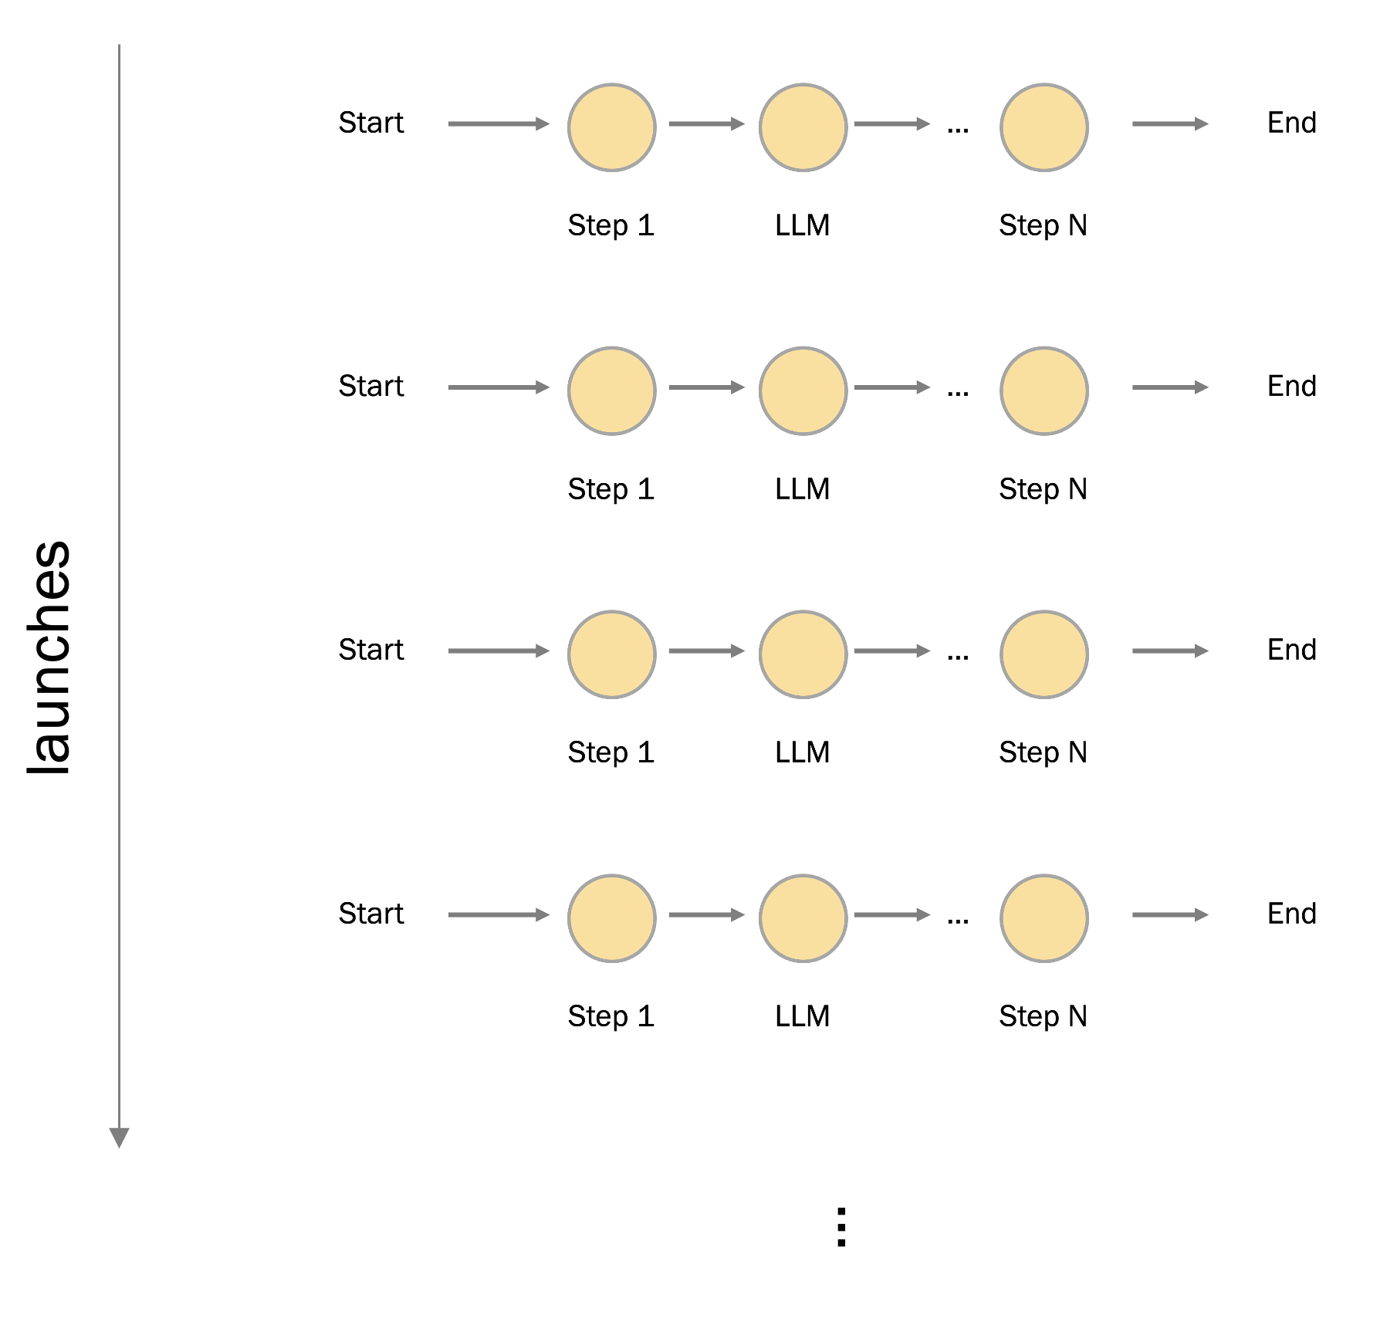
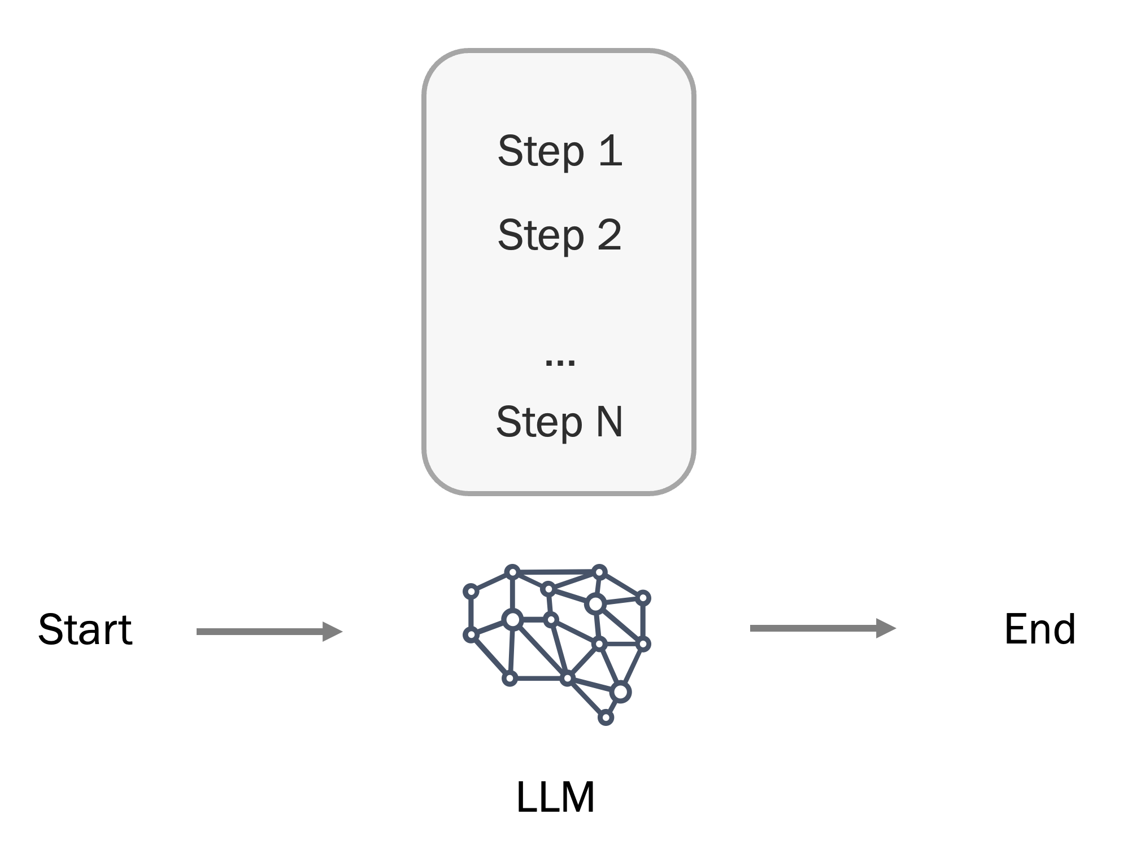
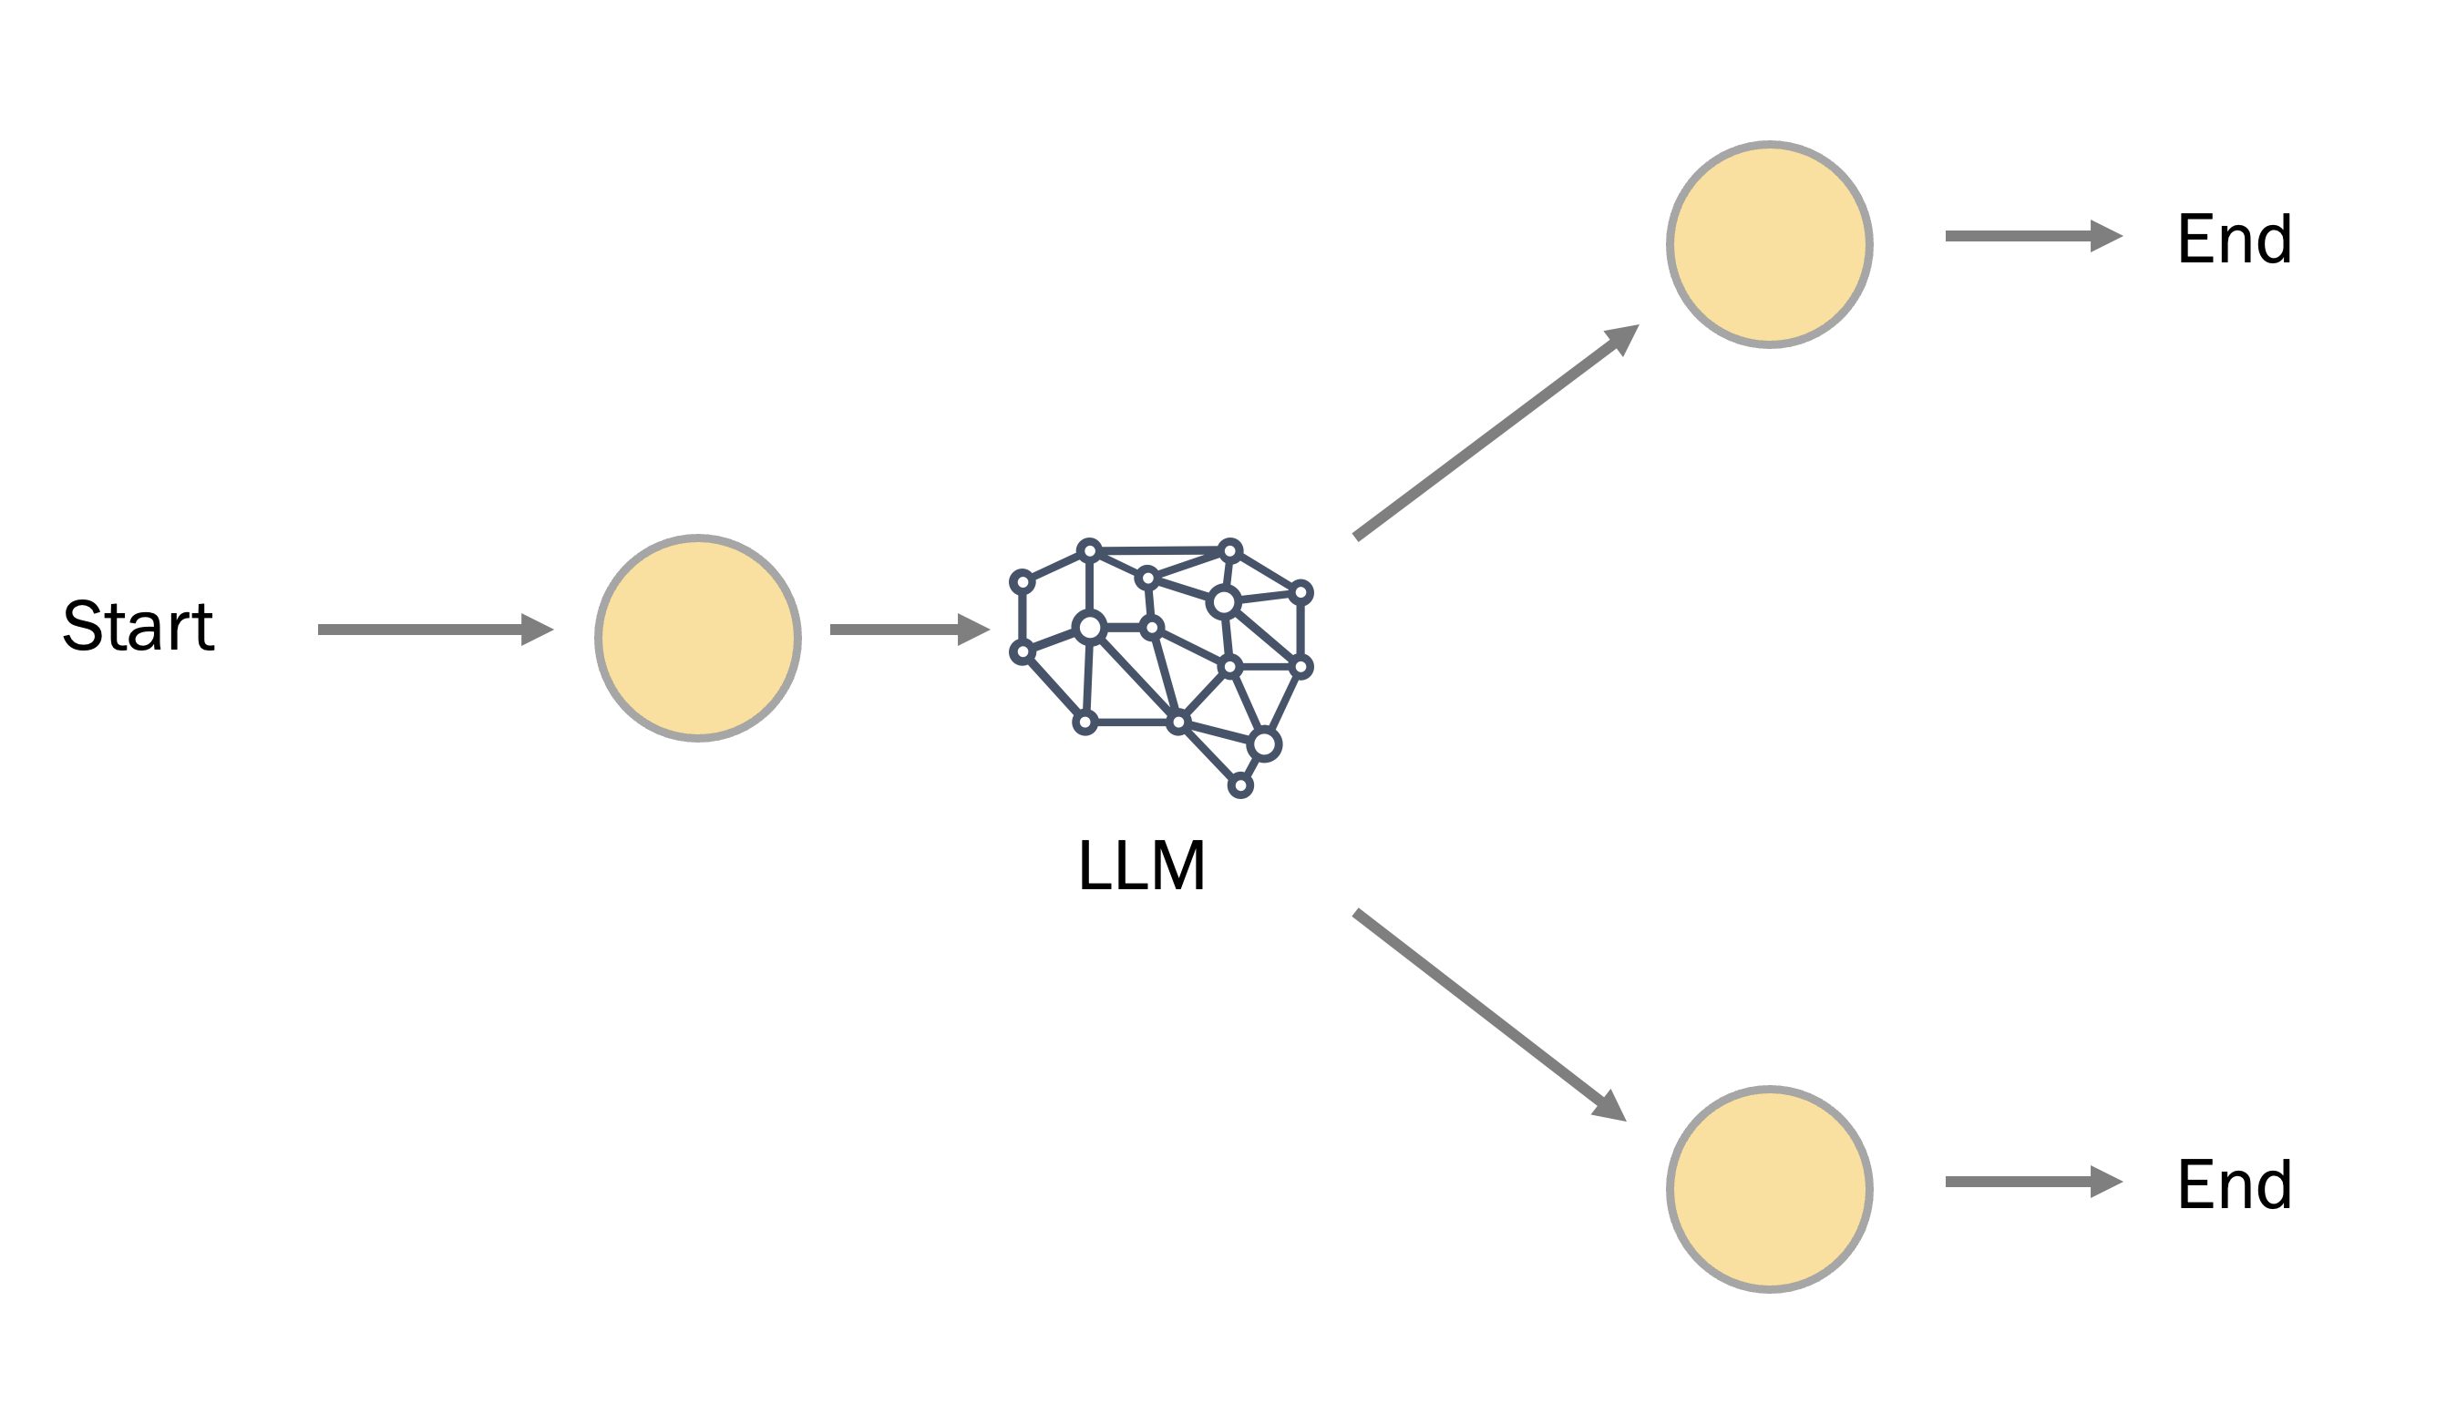
Extremes
Chain
Router
Full autonomy

Slide 10
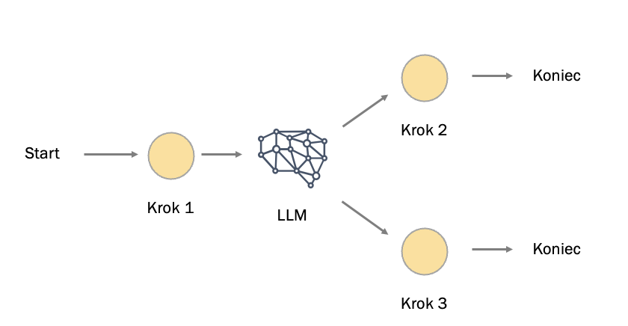
Router
Full autonomy
Graphs help maintain credibility when handing over the reins to AI
The greater the autonomy of the LLM, the lower its credibility....

Slide 11
LLM Applications are pipelines of components and artifacts

Slide 12



Chains
step 1
step 2
...
step n
LCEL
LangChain
Expression
Language
chain = prompt | step_1 | step_2 | step_n | output_parser

Slide 13
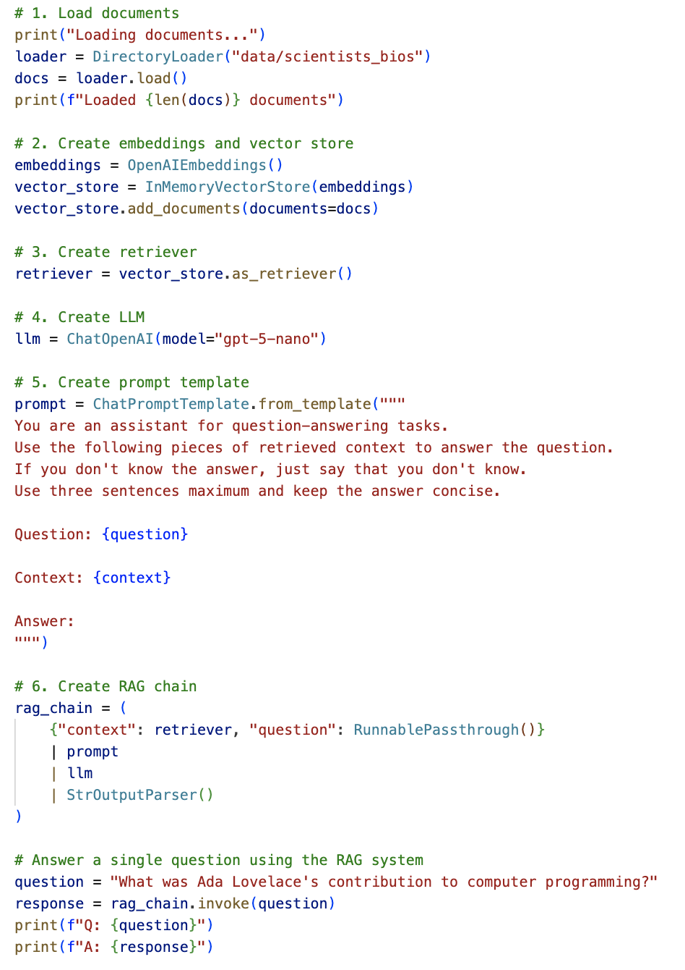
Chains

Slide 14
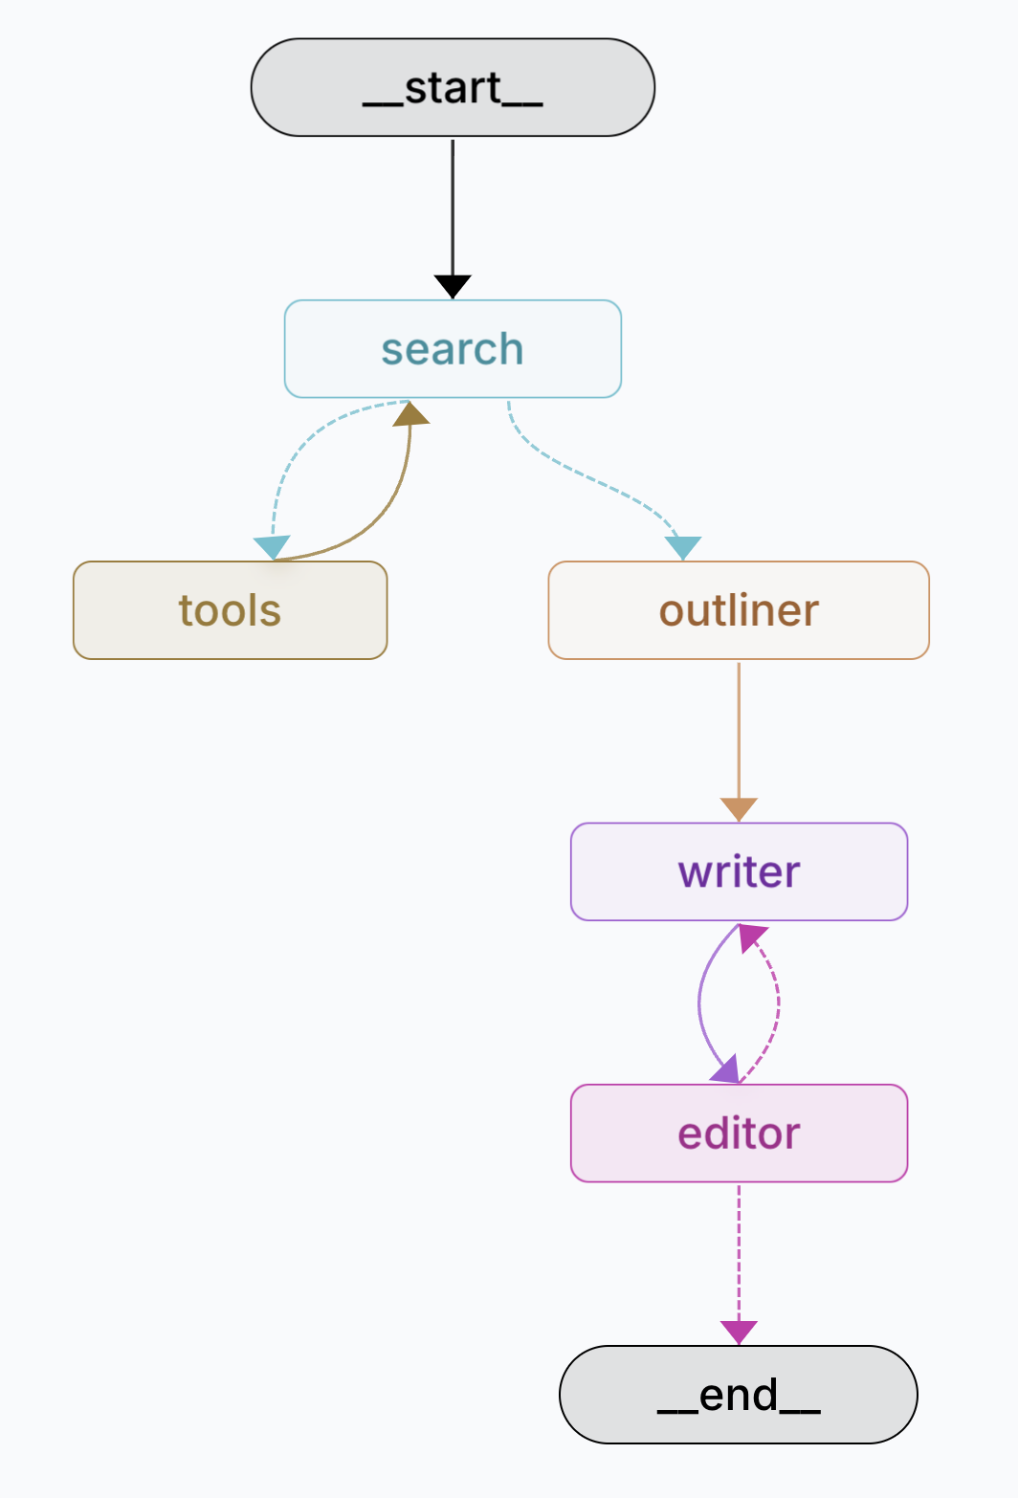
Graphs

Slide 15
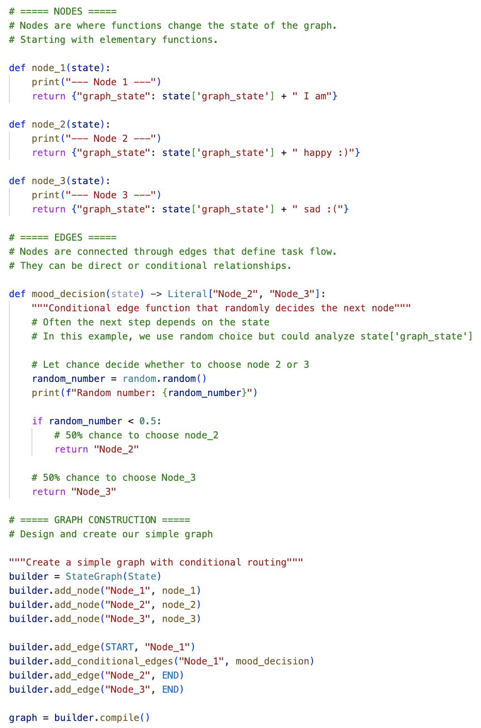
Components can be elementary functions....

Slide 16
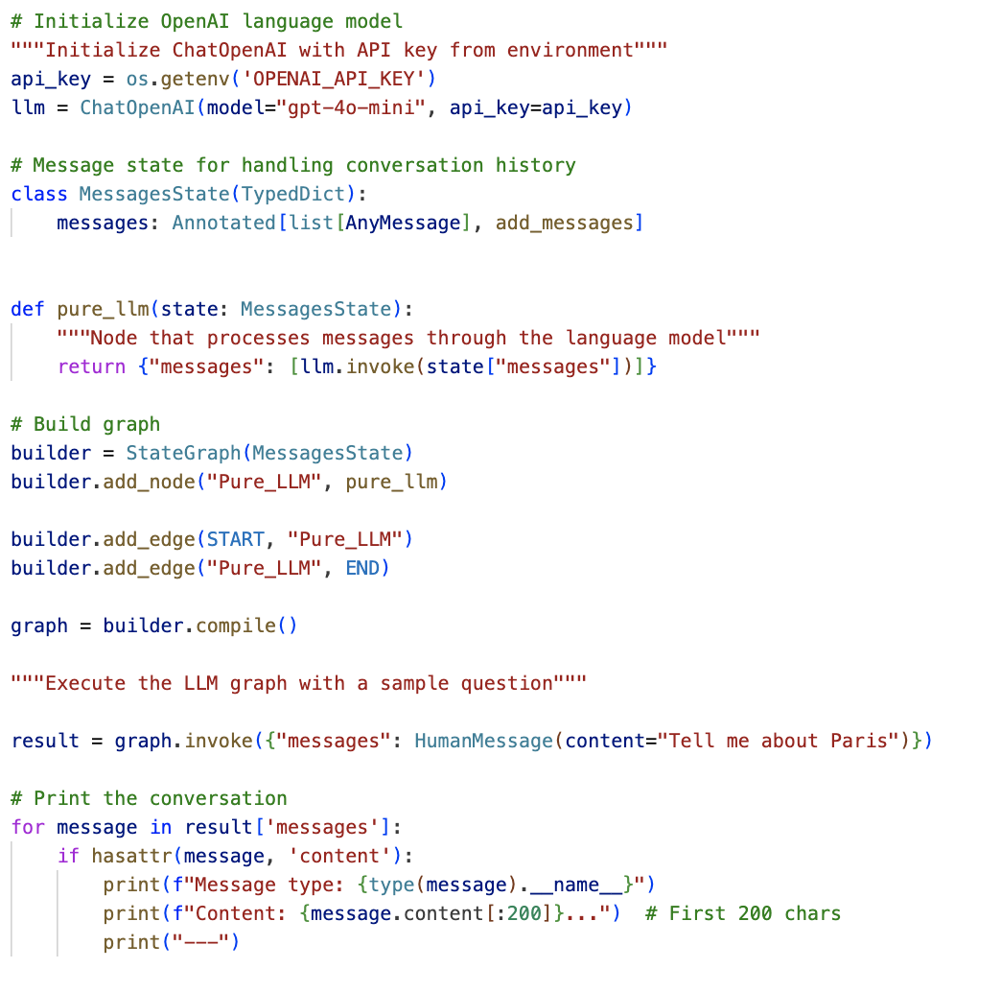
... modules using LLM ...

Slide 17
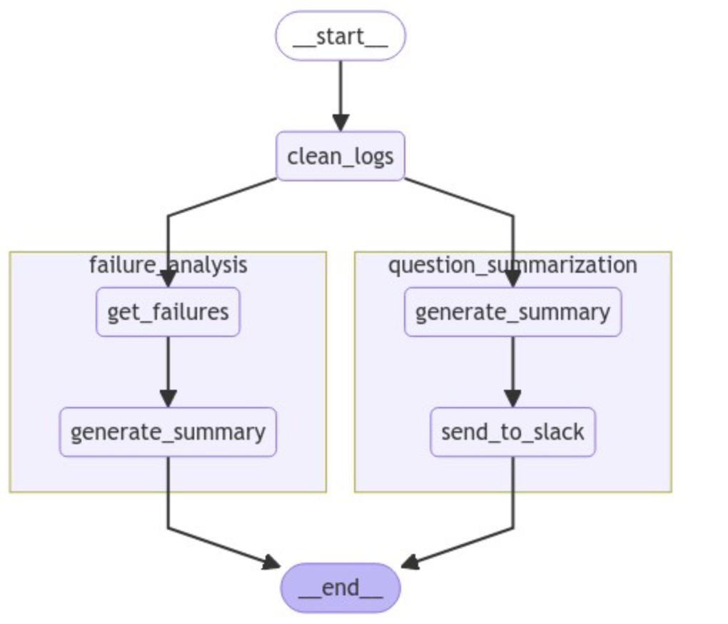
... or other graphs

Slide 18
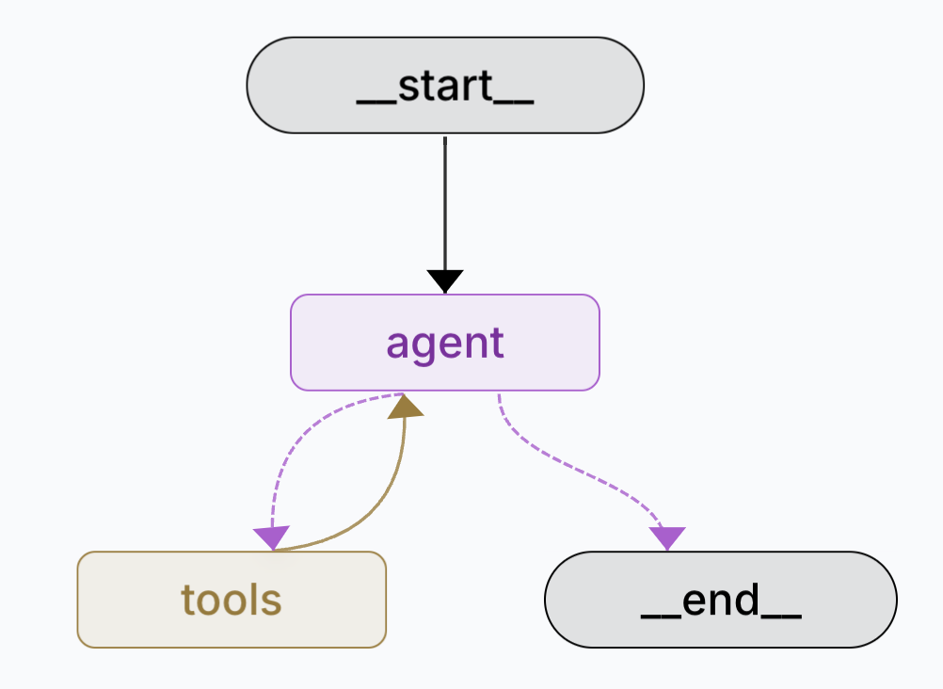




Slide 19


Slide 21
Flow engineering

Slide 22
In a graph, you can include "decision points"

Slide 23
"deterministic”
branches
End
if a = 0: Step 2
else:
Step 3
Step 2
Start
Step 1
End
Step 3

Slide 24
"non-deterministic”
branches
End
Step 2
Start
Depend on the state of the graph or LLM decision
Step 1
LLM
End
Step 3

Slide 25
You can use loops (recurrences)

Slide 26
This forms the basis for reflexive mechanisms
ReAct = Reason and Act
Start
...
End
Step 1
LLM
Step N

Slide 27
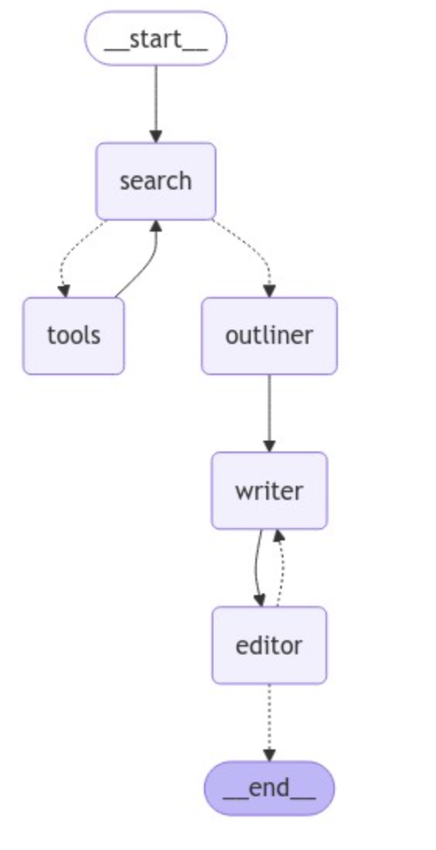
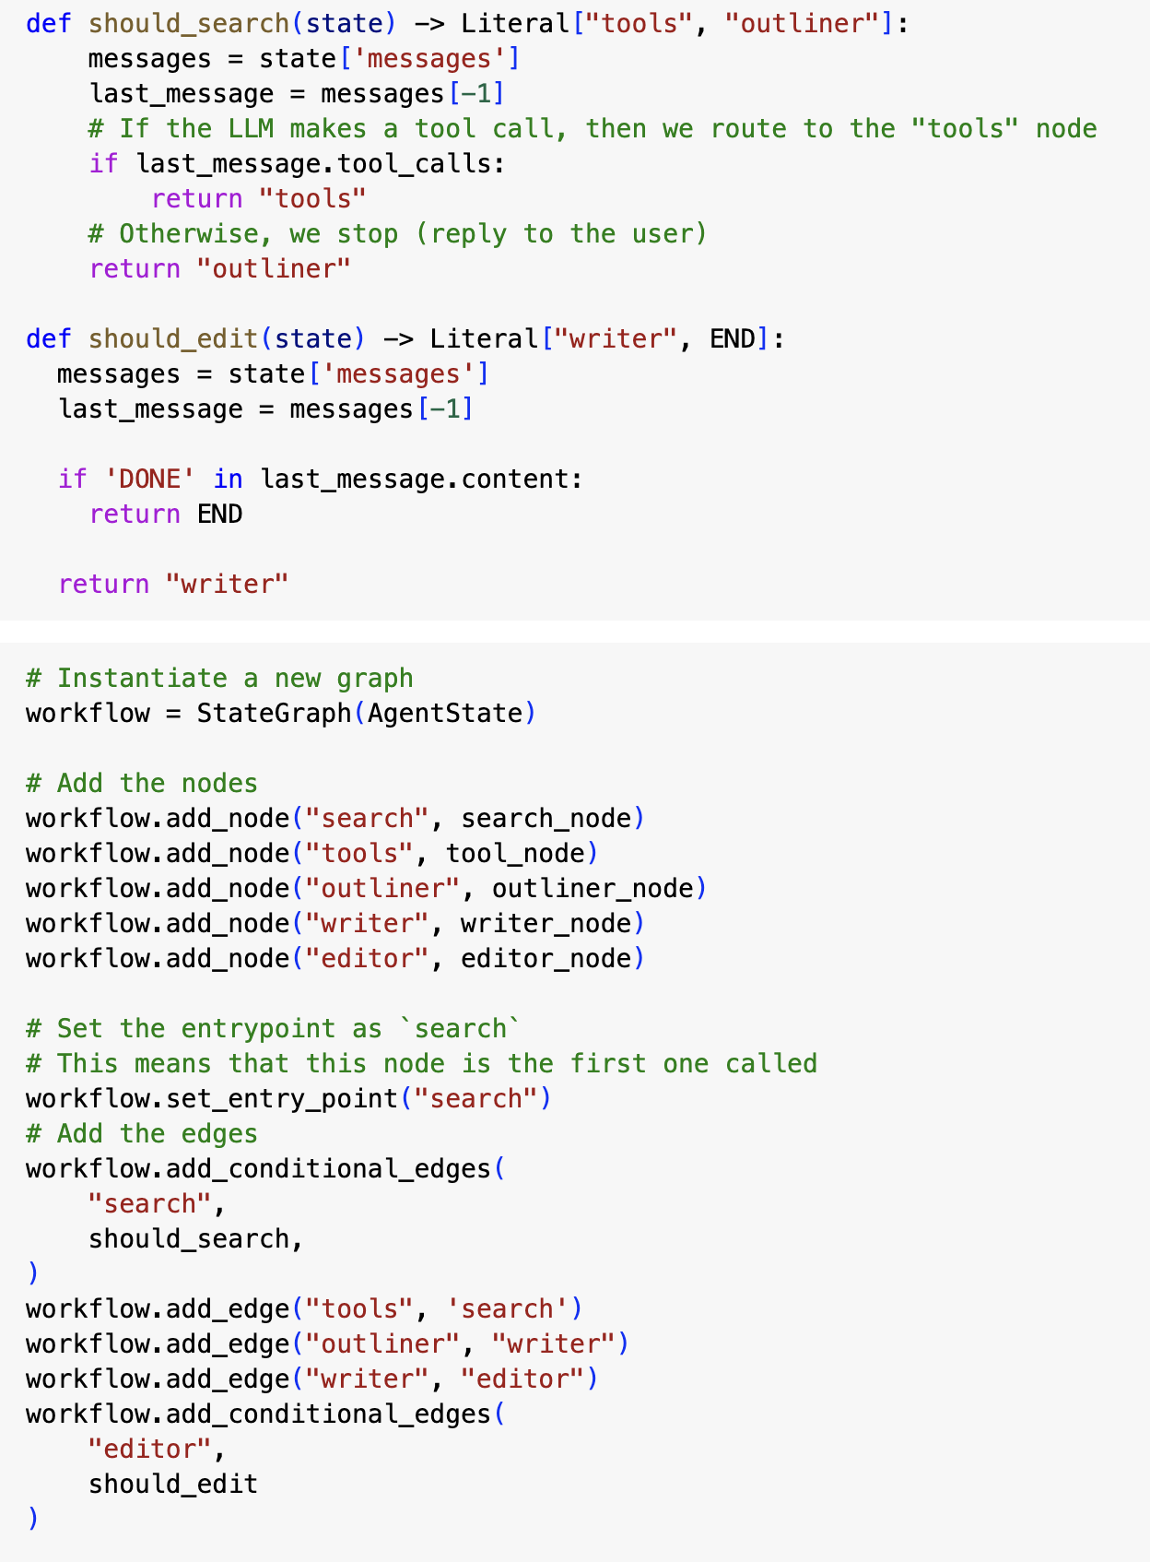

Slide 28
Human can also be included … (Human-in-the-Loop)
Start
...
End
Step 1
LLM
Step N

Slide 29
In a certain situation…
Startup
...
End of
Step 1
LLM
Step N

Slide 30
… or permanently
Startup
...
End of
Step 1
LLM
Step N

Slide 31
Processes in a graph can be branched into multiple parallel threads (MAP > REDUCE)

Slide 32
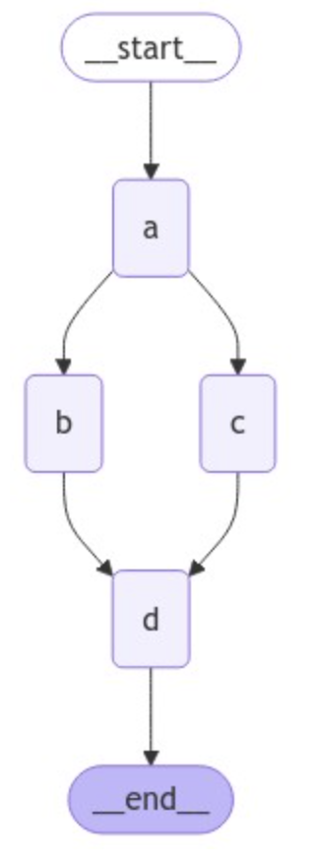
This reduces the response time
and allows the system to scale

Slide 33
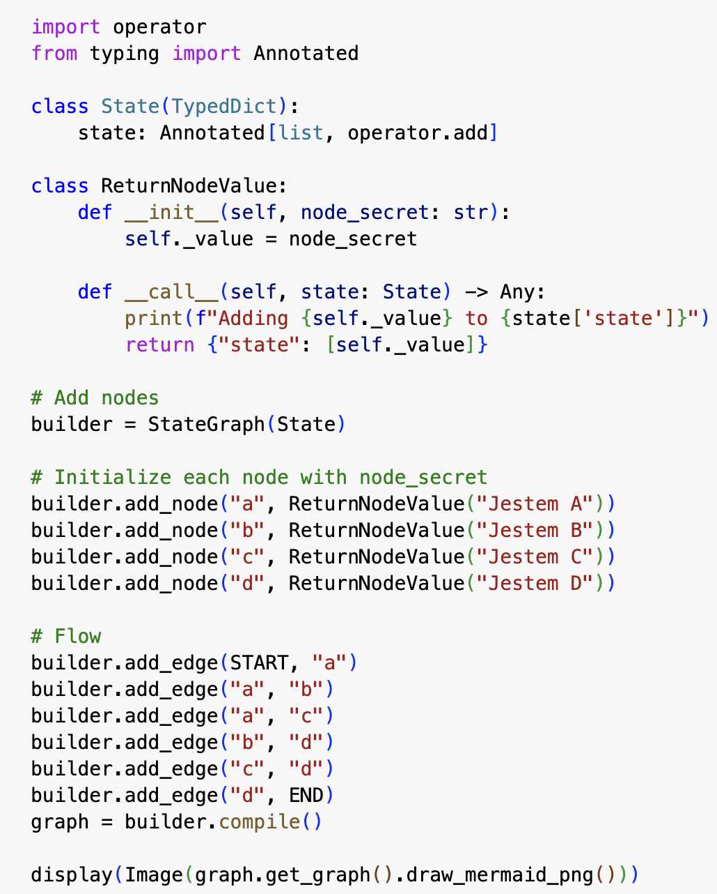

Slide 34
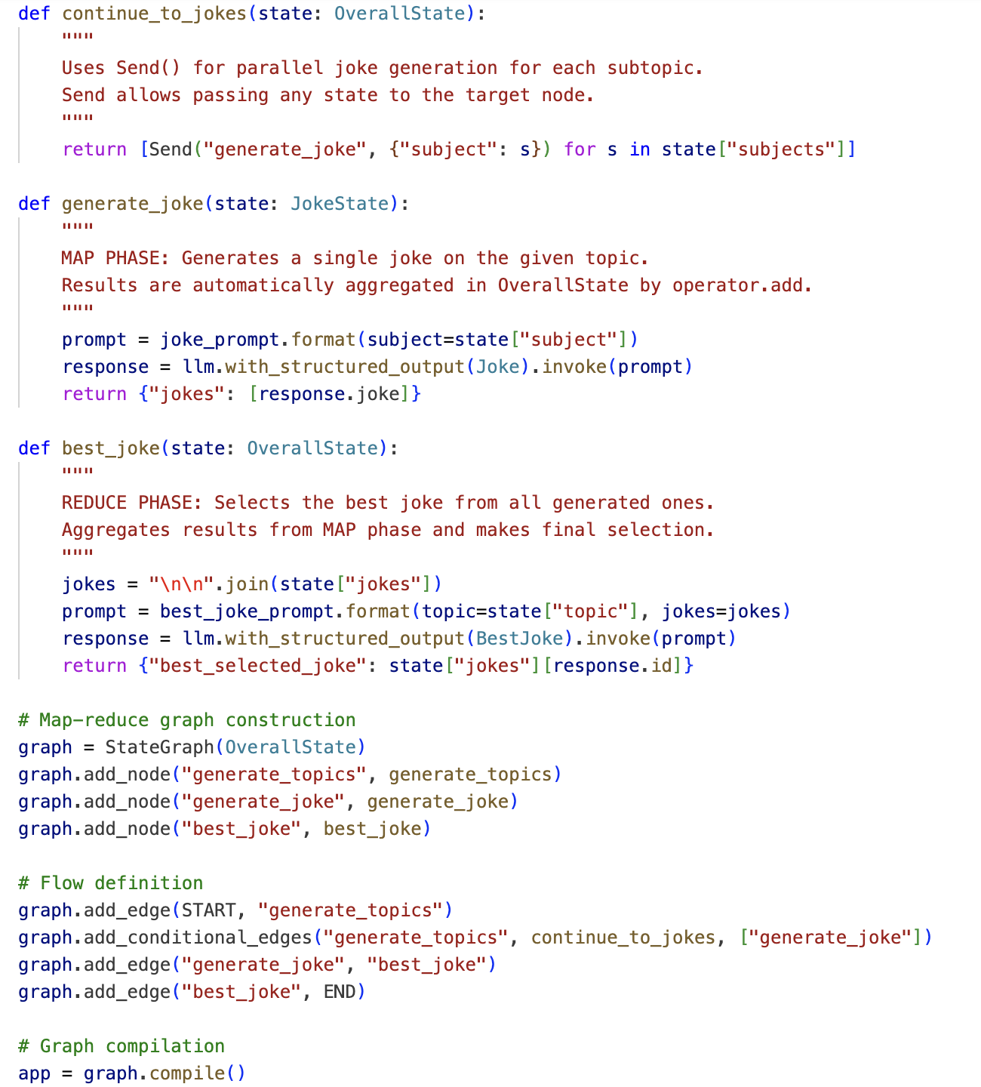

Slide 35
Processes can be composed from multiple subgraphs

Slide 36
__start__
create_analysts
user feedback
Such graphs can perform separate tasks.
They are often referred to as agents
__start__
ask question
search wikipedia
search internet
answer the question
save the interview
write the section
write summary
write report
write introduction
finalize report
__end__

Slide 37
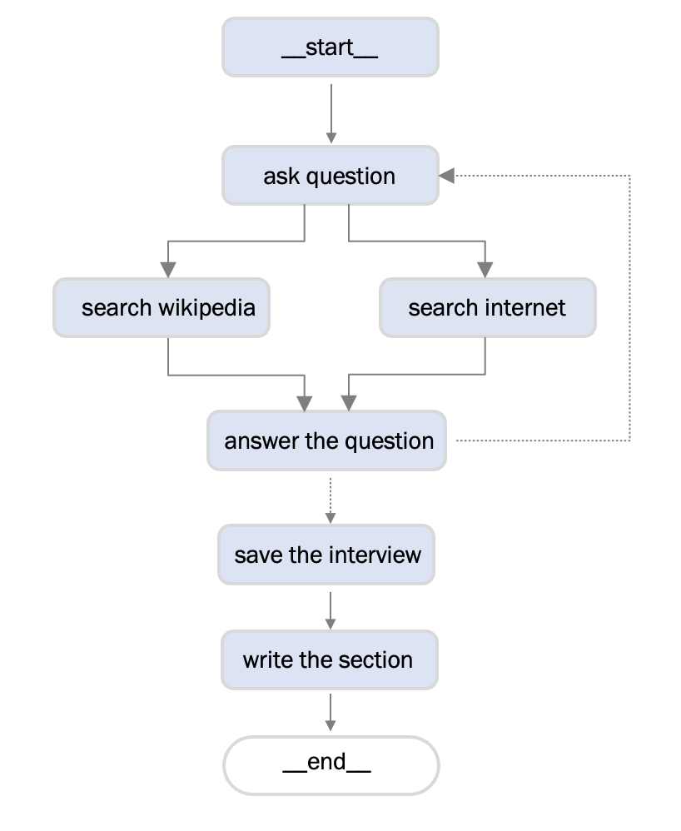
Any such agent may have a private state....

Slide 38
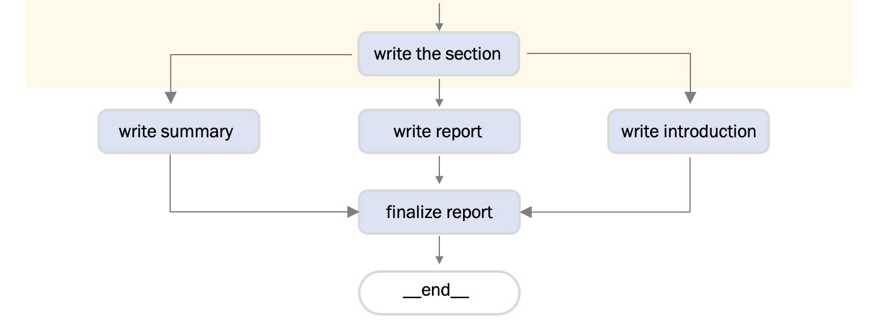
... And have access to the public state

